Slide 1
Basic terminologies (Assembler, compiler, interpreter, data, information, knowledge)
By: Engr. Fahama Barakzai

Slide 2
What are Language Processors?
A language processor, or translator, is a computer program that translates source code from one programming language to another. They also identify errors during translation.
Compilers, Interpreters, translate programs written in high-level languages into machine code that a computer understands and Assemblers translate programs written in low-level or assembly language into machine code.

Slide 3
Types of Language Processors:
Compiler
Assembler
Interpreter

Slide 4
Compiler:
The language processor that reads the complete source program written in high-level language as a whole in one go and translates it into an equivalent program in machine language is called a Compiler. Example: C, C++, C#.
The source code is translated to object code successfully if it is free of errors.

Slide 5
Compiler:
The compiler specifies the errors at the end of the compilation with line numbers when there are any errors in the source code.
The errors must be removed before the compiler can successfully recompile the source code again the object program can be executed number of times without translating it again.

Slide 6
Assembler:
The Assembler is used to translate the program written in Assembly language into machine code.
The source program is an input of an assembler that contains assembly language instructions. The output generated by the assembler is the object code or machine code understandable by the computer.
We need an assembler to fill the gap between human and machine so that they can communicate with each other.

Slide 7
Assembler:
Code written in assembly language is some sort of mnemonics(instructions) like ADD, MUL, MUX, SUB, DIV, MOV and so on, and the assembler is basically able to convert these mnemonics in binary code.

Slide 8
Interpreter:
The translation of a single statement of the source program into machine code is done by a language processor and executes immediately before moving on to the next line is called an interpreter.
If there is an error in the statement, the interpreter terminates its translating process at that statement and displays an error message.
The interpreter moves on to the next line for execution only after the removal of the error.

Slide 9
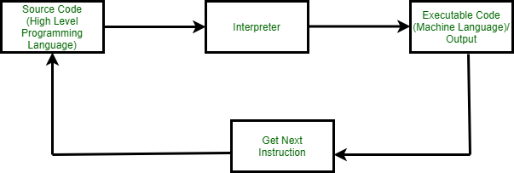
Interpreter:
An Interpreter directly executes instructions written in a programming or scripting language without previously converting them to an object code or machine code. Example: Perl, Python and MATLAB.
An interpreter translates one line at a time and then executes it.

Slide 10
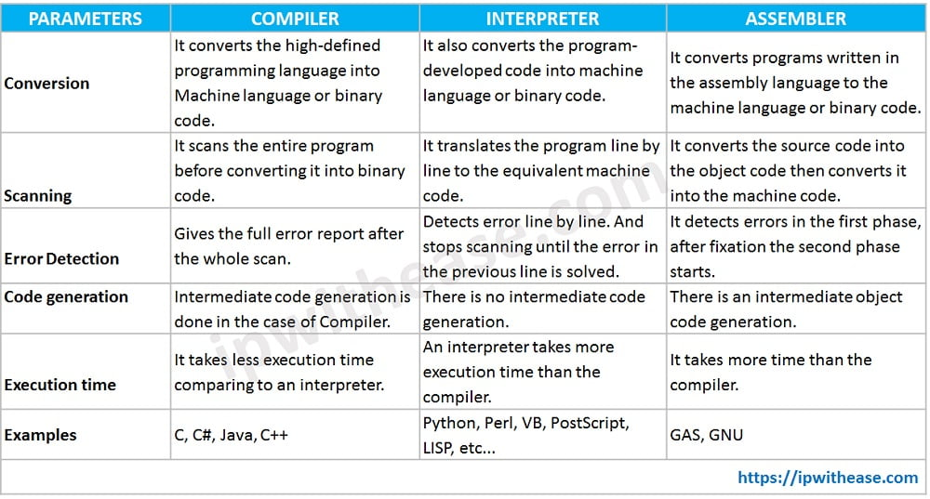
Difference b/w Compiler, Assembler and Interpreter:

Slide 11
Data, Information & Knowledge:
Data are the raw alphanumeric values obtained through different acquisition methods.
Information is created when data are processed, organized, or structured to provide context and meaning. Information is essentially processed data.
Knowledge is what we know. Knowledge is the accumulation of past experience and insight by which we interpret, and assign meaning to, information. For knowledge to result in action, an individual must have the authority and capacity to make and implement a decision.
Knowledge are needed to produce actionable information that can lead to an impact.

Slide 12
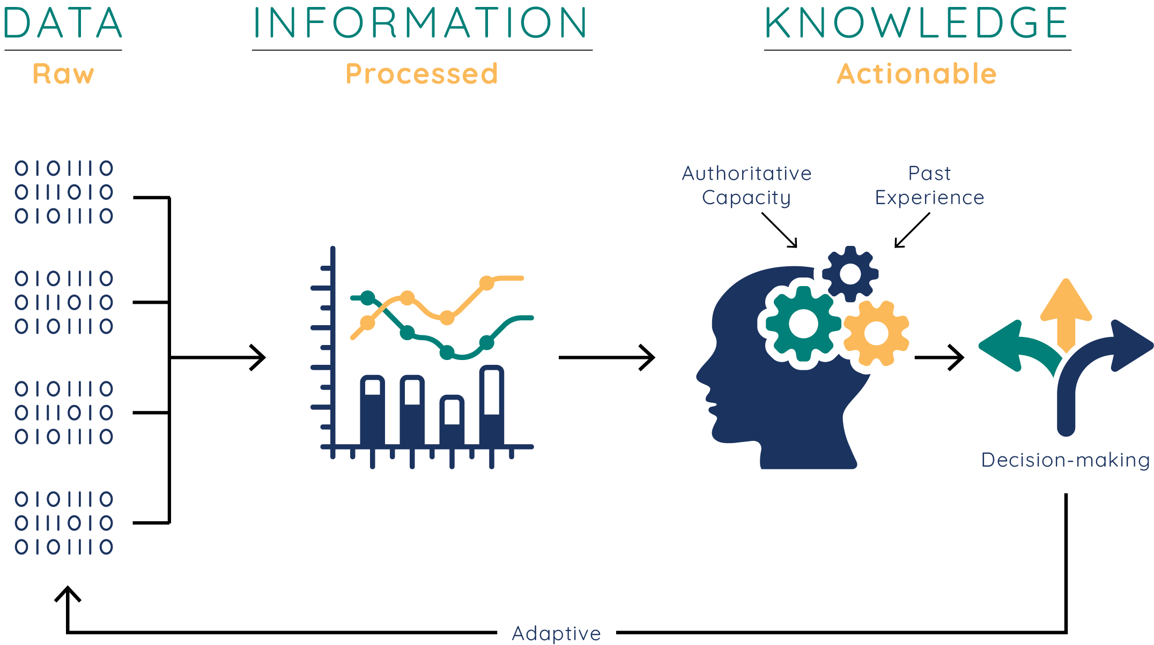

Slide 13
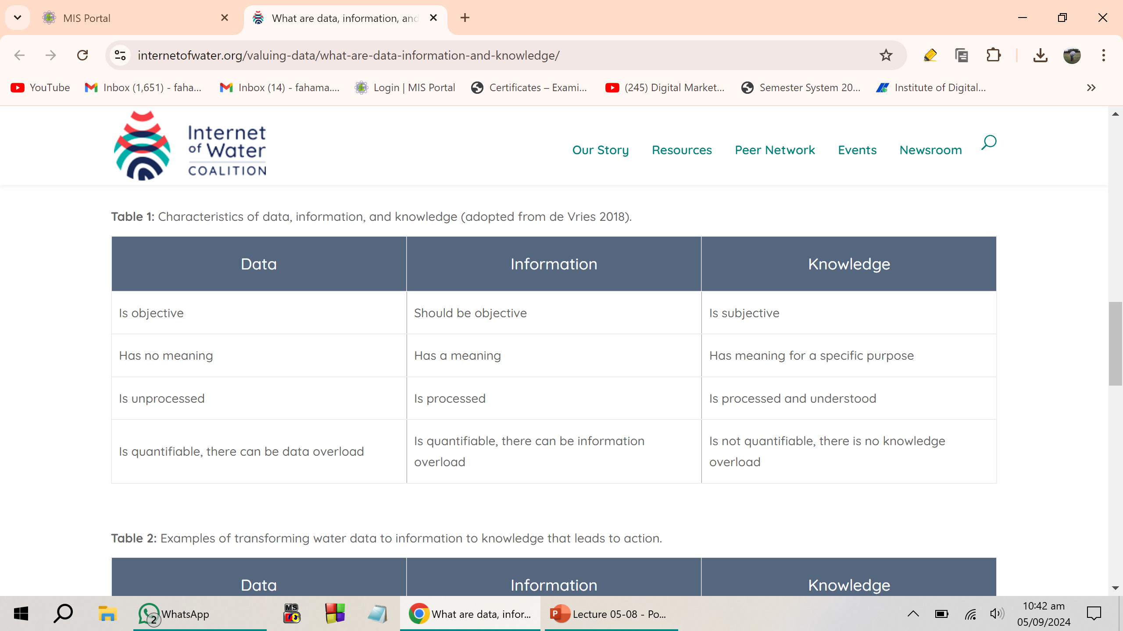
Characteristics of Data, Information & Knowledge:

